Slide 1
Nuclear Fuel Performance
NE-533
Spring 2024

Slide 2
Last Time
Solid mechanics predicts the deformation of a body from its applied load
Elastic deformation and plastic deformation
Concepts of stress and strain
Elastic moduli and Elastic constants
Work hardening/strain hardening
Toughness, ductility, DBTT, etc.

Slide 3
Mechanics

Slide 4
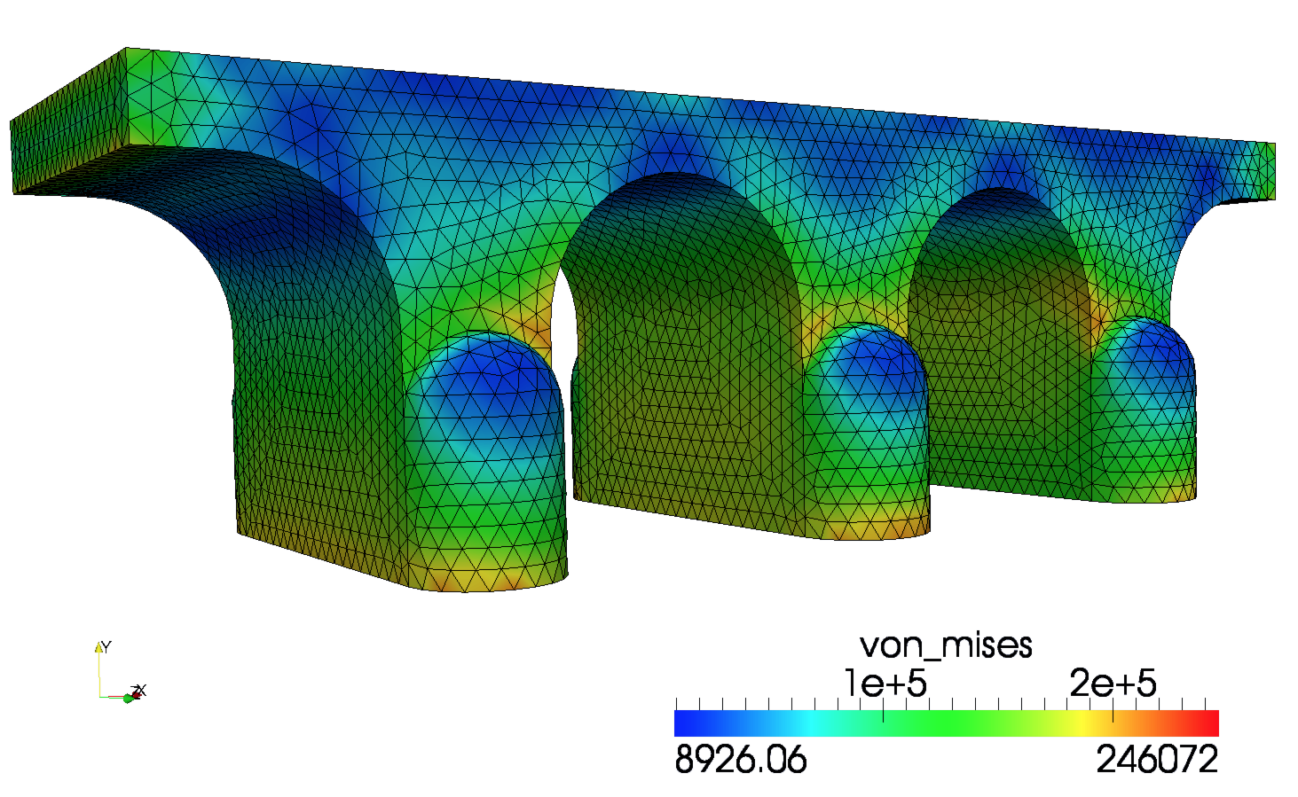
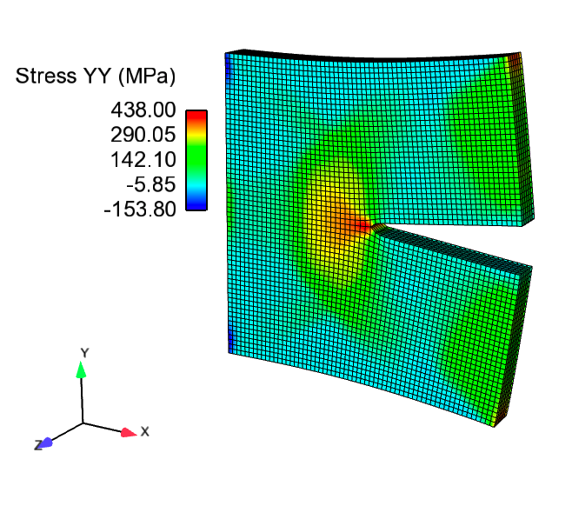
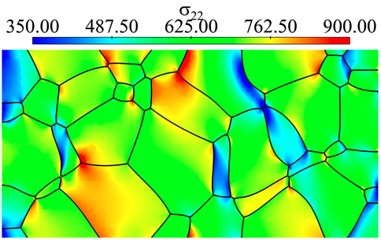
Determine the stress and strain throughout a body

Slide 5
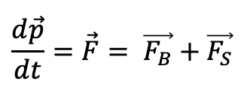
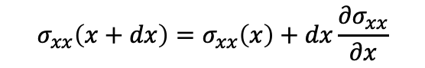
The stress divergence equation derivation
$$\frac{d\vec{p}}{dt}=\vec{F}= \vec{F_{B}}+\vec{F_{S}}$$
Generalized momentum conservation:
Considering a cubic element, surface forces act on the walls of the cube
Force on a wall is the product of the stress and the surface area
For wall at dx, approximate stress via Taylor expansion
$$σ_{xx}\left(x+dx\right)=σ_{xx}\left(x\right)+dx\frac{{∂σ}_{xx}}{∂x}$$

Slide 6
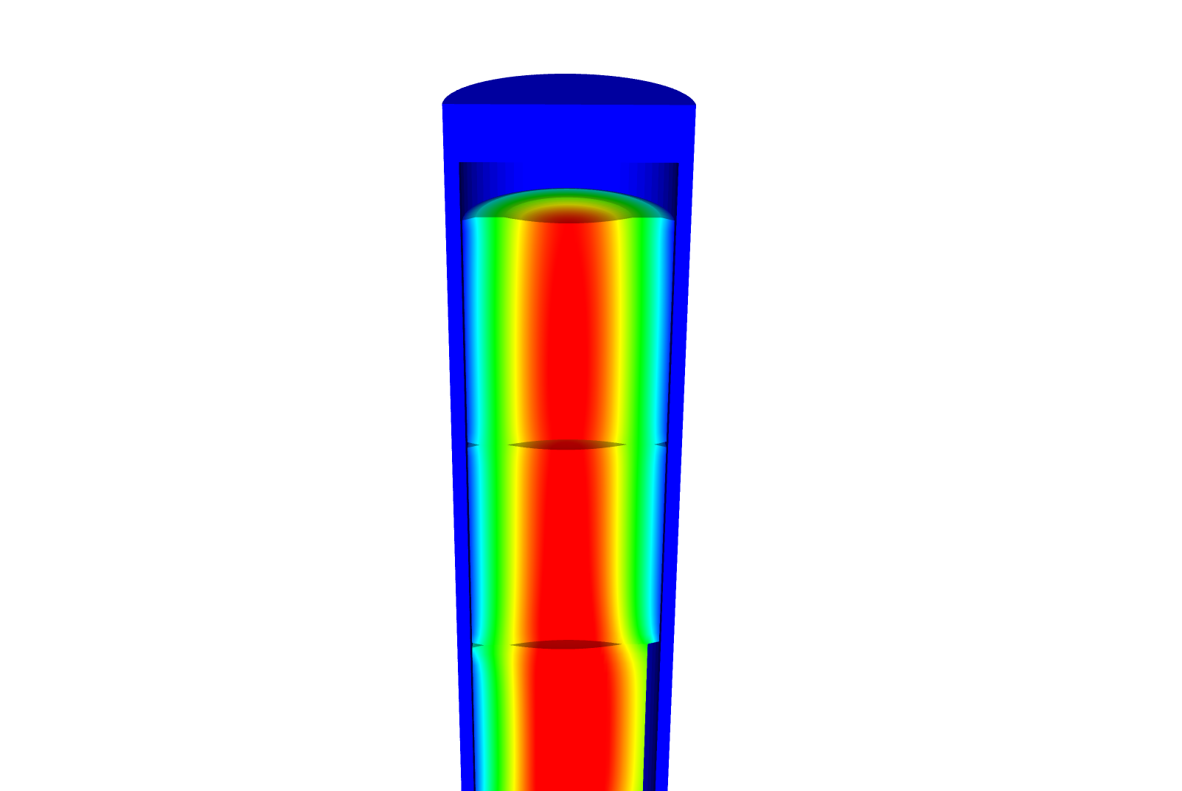
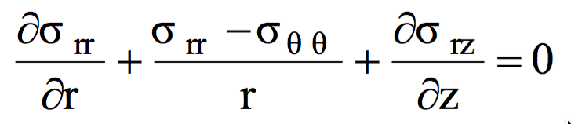
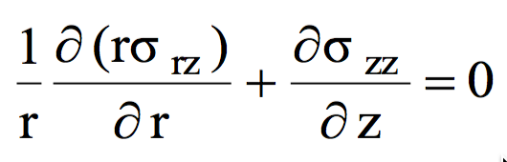
Simplified Cauchy for our typical system
Assumption 1: We have a static body
Assumption 2: Gravity is negligible
Assumption 3: The problem is axisymmetric
z
θ
r

Slide 7
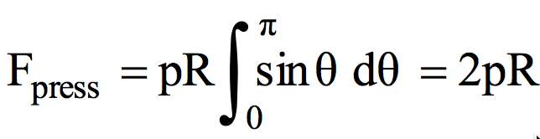
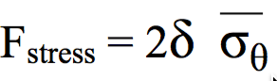
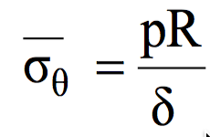
Solve for the stress throughout a pressurized cylinder (cladding tube) with thin walls
Because our cylinder has such thin walls (δ = thickness), we can simplify everything to simple force balance
The hoop stress is the force exerted circumferentially in both directions on every particle in the cylinder wall
First, we need the Force per unit length due to the pressure
Utilize force to hoop stress relation:
Then we equate the forces and solve for the hoop stress

Slide 8
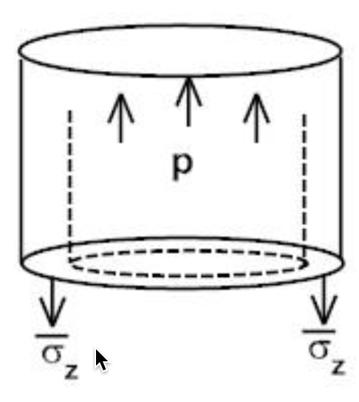
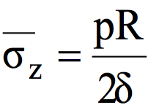
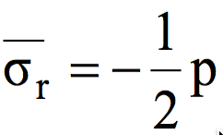
Other two stresses for a thin-walled closed cylinder
To find the stress in the z-direction we do another force balance
Again, we equate the forces and solve for the stress
Last, the stress on the inside of the wall is –p and on the outside is zero
F_{top}
F_{wall}

Slide 9
Determine if a fuel rod will exceed its yield stress
A fuel rod has an initial pressure of 5 MPa that increases to 9 MPa during operation. Will it exceed its yield stress?
R = 0.55 cm, δ = 0.05 cm, σ_{y} = 381 MPa
The largest stress will be the hoop stress
The hoop stress is P*(0.55/.05)
For 5 MPa, σθ = 55 Mpa
For 9 MPa, σθ = 99 Mpa
With these pressures, we don’t come even close to the yield stress of the cladding

Slide 10
Develop constitutive relations for thick-walled
We assume small strains, so the strain is defined with respect to displacement: u
We assume isotropic material response:

Slide 11
Small strain theory
In continuum mechanics, the infinitesimal strain theory is a mathematical approach to the description of the deformation of a solid body in which the displacements of the material particles are assumed to be much smaller than any relevant dimension of the body so that its geometry and the constitutive properties of the material at each point of space can be assumed to be unchanged by the deformation
With this assumption, the equations of continuum mechanics are considerably simplified
The small strain theory is commonly adopted in civil and mechanical engineering for the stress analysis of structures built from relatively stiff elastic materials

Slide 12
Stress within a pressurized cylinder that has thick walls (radius/thickness<20)
The cylinder as an inner radius R_{i} and an outer Radius R_{o}
We assume there is no shear stress, so σ_{rz} = 0
We will begin with the r equation
Now we need our constitutive law
We combine these equations to get

Slide 13
Develop equations for the stress within a pressurized cylinder with thick walls
We need one more relationship from the definition of the strain
From the previous slide, we have
If we combine these, we get
Again, from the previous slide
We end up with

Slide 14
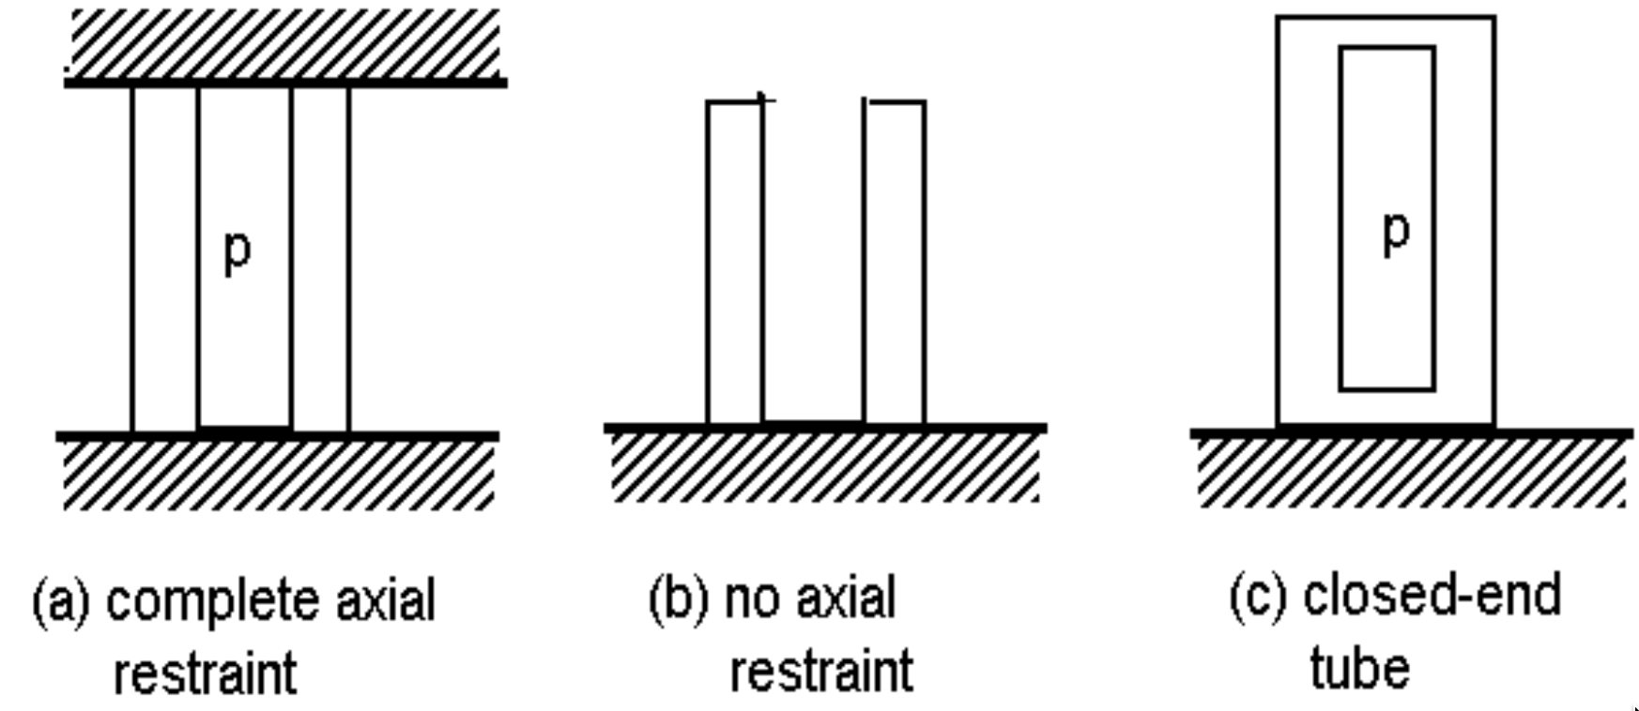
We now have an ODE so we can solve to get the stress
Our boundary conditions are σ_{rr}(R_{i}) = -p and σ_{rr}(R_{o}) = 0
After integrating twice, we get
From σ_{rr}, we can get σ_{θθ} from
From the end condition, we determine σ_{zz}
(a)
(b)
(c)

Slide 15
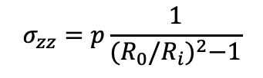
Determine if a fuel rod will exceed its yield stress
A fuel rod has an initial pressure of 5 MPa that increases to 9 MPa during operation. Will it exceed its yield stress?
R_{i} = 0.52, R_{o} = 0.58 cm, σ_{y} = 381 MPa
$$σ_{zz}=p\frac{1}{{(R_{0}/R_{i})}^{2}−1}$$
Which stress is the largest?
σ_{θθ}
At what position r will the hoop stress be the largest?
r = R_{i} = 0.52 cm
What is the stress at p = 5 MPa?
σ_{θθ} = 5*((0.58/0.52)^2 + 1)/((0.58/0.52)^2 – 1) = 46.0 MPa
What is the stress at p = 9 Mpa?
σ_{θθ} = 5*((0.58/0.52)^2 + 1)/((0.58/0.52)^2 – 1) = 82.7 Mpa
Again, we don’t even get close to yielding

Slide 16
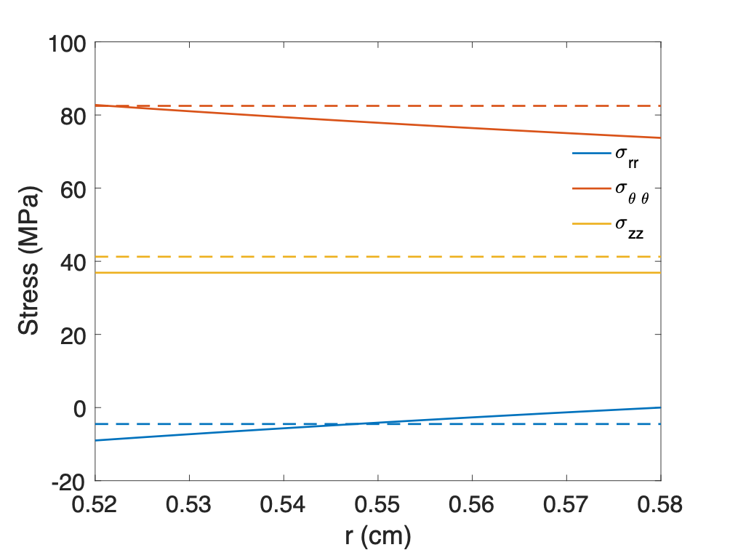
We’ve now solved this same problem assuming thin and thick-walled cylinders

Slide 17
THERMO-Mechanics

Slide 18
Thermal Expansion
As the temperature increases, atoms have larger vibrations, causing the material to expand
This expansion doesn’t raise the energy of the material when unrestrained
This expansion can be treated as a strain, but as one that doesn’t cause stress

Slide 19
Thermal Expansion
In isotropic materials, thermal expansion happens equally in all directions and is linear with temperature
$ε_{0}=\left(T − T_{0}\right)αI$
In this equation
T is the current temperature
T₀ is the temperature the original size was measured
α is the linear thermal expansion coefficient
I is the identity tensor

Slide 20
Thermal Expansion
Though thermal expansion doesn’t directly cause stress, it can still lead to thermal stress

Slide 21
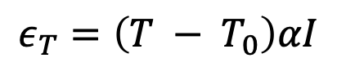
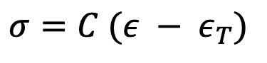
What is the stress in a thin constrained rod of length L when it is heated to ΔT?
The rod has a Young’s modulus of E and an expansion coefficient of α
$$ε_{T}=\left(T − T_{0}\right)αI$$
$σ=C (ε − ε_{T})$
$$ε_{0}=\left(T − T_{0}\right)α$$
$σ=E (0 − ΔTα)$
$σ=−EΔTα$

Slide 22
The large temperature gradient within a fuel pellet results in large thermal stresses

Slide 23
Consider the constitutive relations plus T
We assume small strains, so the strain is defined as
We assume isotropic material response, so

Slide 24
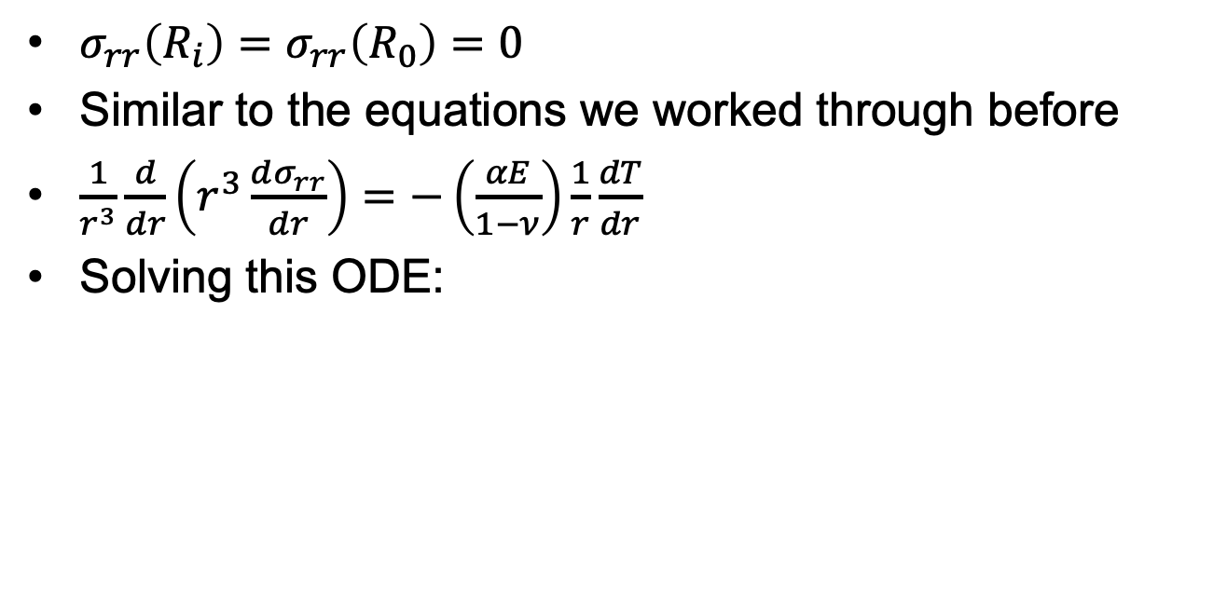
Consider a cylinder with thermal expansion but not pressure
$σ_{rr}\left(R_{i}\right)=σ_{rr}\left(R_{0}\right)=0$
Similar to the equations we worked through before
$\frac{1}{r^{3}}\frac{d}{dr}\left(r^{3}\frac{dσ_{rr}}{dr}\right)=−\left(\frac{αE}{1−ν}\right)\frac{1}{r}\frac{dT}{dr}$
Solving this ODE:

Slide 25
What is the hoop stress in the cladding?
$$σ_{θθ}$$
r
R_{i}
R_{f}

Slide 26
Where is hoop stress equal to zero?
$$σ_{θθ}\left(r\right)=\frac{1}{2}ΔT\frac{αE}{1−ν}\left(1−2\frac{R_{i}}{δ}\left(\frac{r}{R_{i}}−1\right)\right)=0$$
$$\left(1−2\frac{R_{i}}{δ}\left(\frac{r}{R_{i}}−1\right)\right)=0$$
$$\left.2\frac{R_{i}}{δ}\left(\frac{r}{R_{i}}−1\right)\right.=1$$
$$\left.\left(\frac{r}{R_{i}}−1\right)\right.=\frac{δ}{{2R}_{i}}$$
$$\left. r\right.=\frac{δ}{2}+R_{i}$$

Slide 27
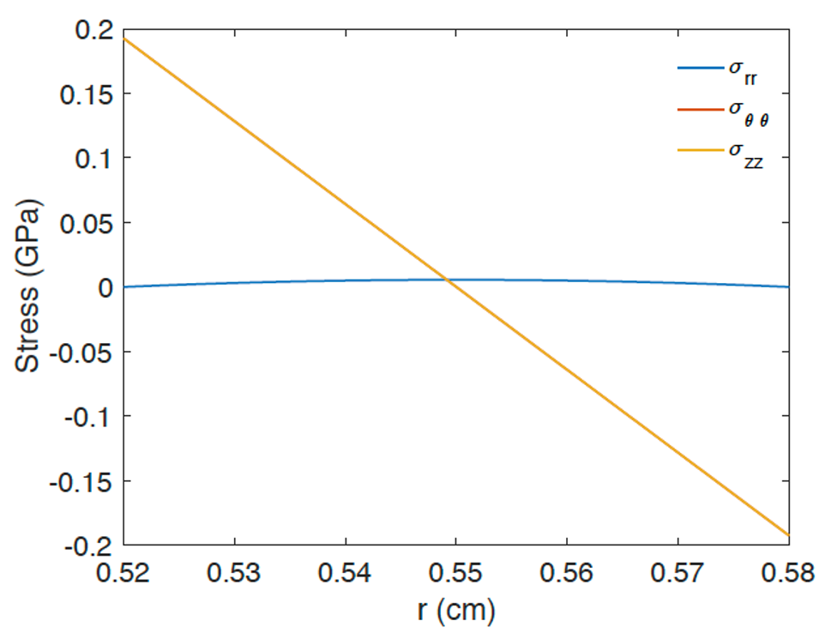
The linear temperature gradient across the cladding causes axial thermal stresses

Slide 28
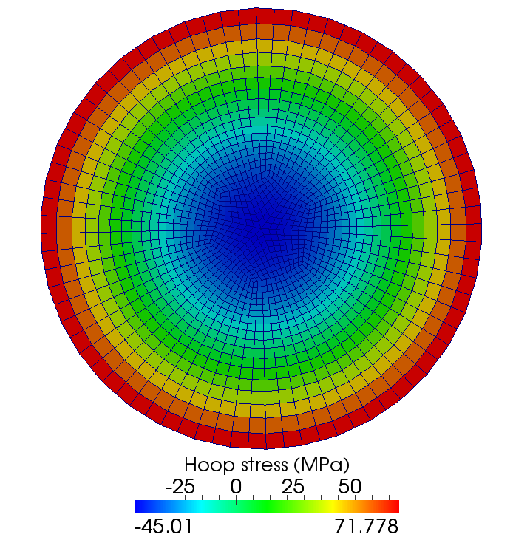
Same approach to the thermal stress in a fuel pellet
The thermal stress is due to the temperature gradient

Slide 29
Solve this stress ODE
The boundary conditions are:
Once we solve it, we obtain
Then we can solve the hoop stress
The axial stress is more complicated to obtain, but you end up with

Slide 30
The fuel temperature gradient causes large thermal stresses

Slide 31
Example

Slide 32
How far do fuel cracks extend?
E = 200 GPa, ν = 0.345, α = 11.0e-6 1/K, σ_{fr} = 130 MPa, ΔT = 550 K
Solve for η
– σ_{fr} / σ* = 1 – 3 η²
3 η² = 1 + σ_{fr} / σ*
η = ( (1 + σ_{fr} / σ*)/3 )^{½}
σ* = 11.0e-6*200*550/(4*(1 – 0.345) ) = 461.8 MPa
η = sqrt( (1 + 130/461.8)/3 ) = 0.65

Slide 33
Summary
We derived two analytical solutions for the stress in a pressurized cylinder
Thin-walled cylinder
Thick-walled cylinder
Increases in temperature cause most materials to expand
We call this thermal expansion, which is a strain that doesn’t inherently cause stress
Thermal expansion can cause stress when
Deformation is constrained
There are gradients in the expansion coefficient
There is a temperature gradient
We developed analytical equations for thermal stresses
in the cladding
in the fuel

